Slide 1
Meet the Board of Directors
SPAIN

Slide 2
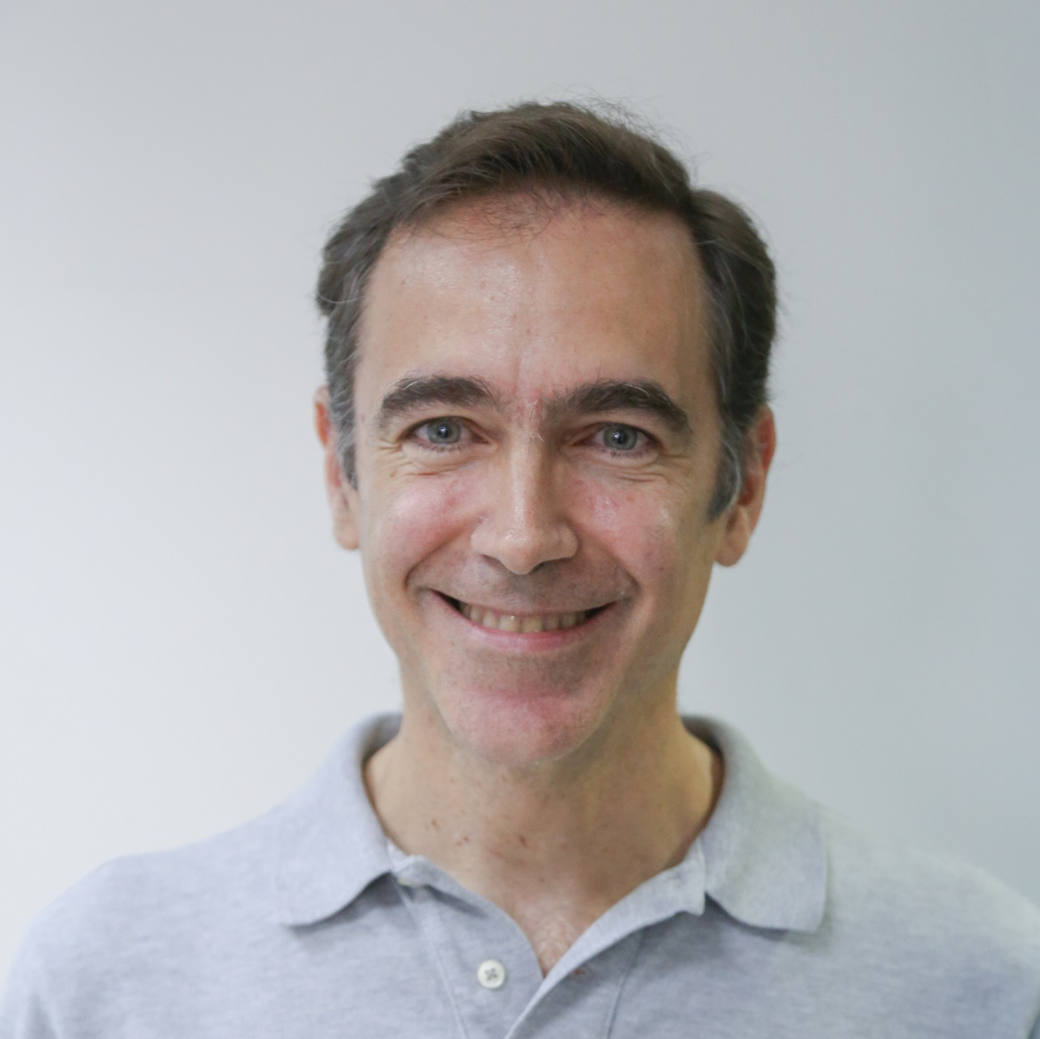
Ramón Taix Board Chair
Ramón Taix joined the board in April 2017 and has been Board Chair since January 2023.
Graduate in Business Administration with extensive experience in management of leading American and European companies, in the health sectors (hospital, primary care and pharmacy channel) and consumer sectors (large distribution, supermarkets and perfumeries). He is currently the General Director of Arkopharma, a laboratory specialized in Phytotherapy and European leader in natural medicine and food supplements.
https://www.linkedin.com/in/ramontaix/

Slide 3
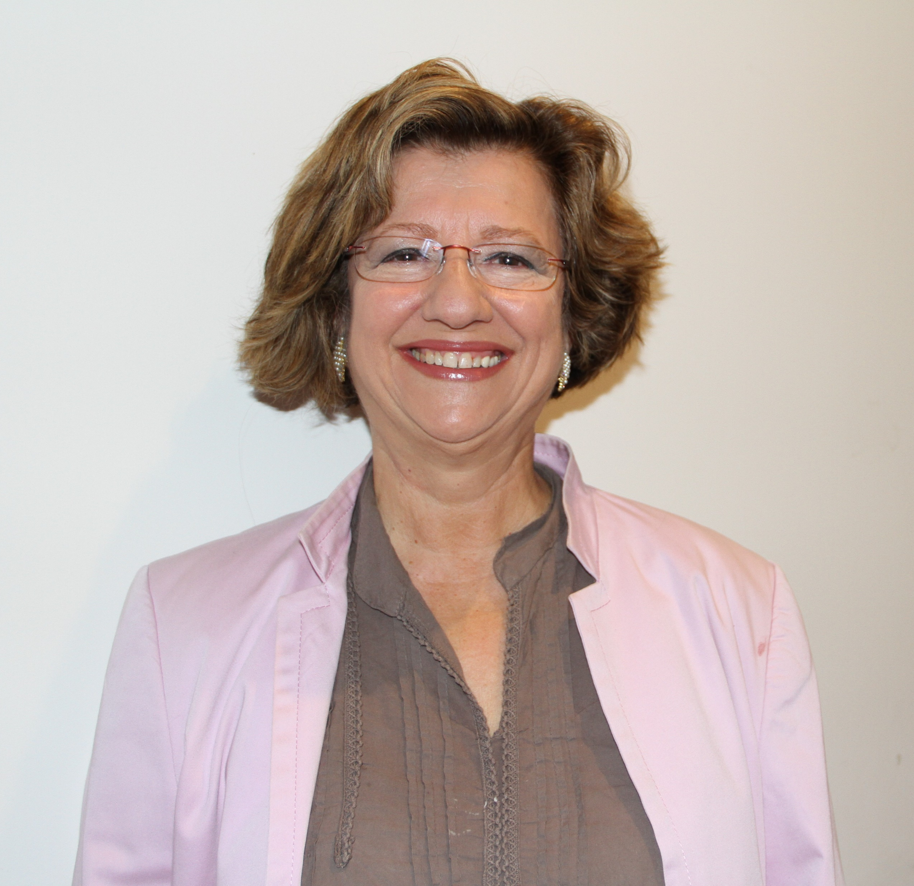
Marisa Muñoz-Caballero Board ViceChair
Marisa Muñoz -Caballero has been a member of the board since 2022 but she was already serving our board for 9 years between 2008 and 2017.
She has a doctorate in Political Science and Sociology. She is a seasoned professional in the management of complex organizations, both multinational (director of Human Resources at Alcatel) and Public Administration (general director of the elderly, manager of the Regional Social Welfare Service in the Community of Madrid.
She is a member of the CGDN
https://www.linkedin.com/in/marisa-mu%C3%B1oz-caballero-25143b19a/

Slide 4
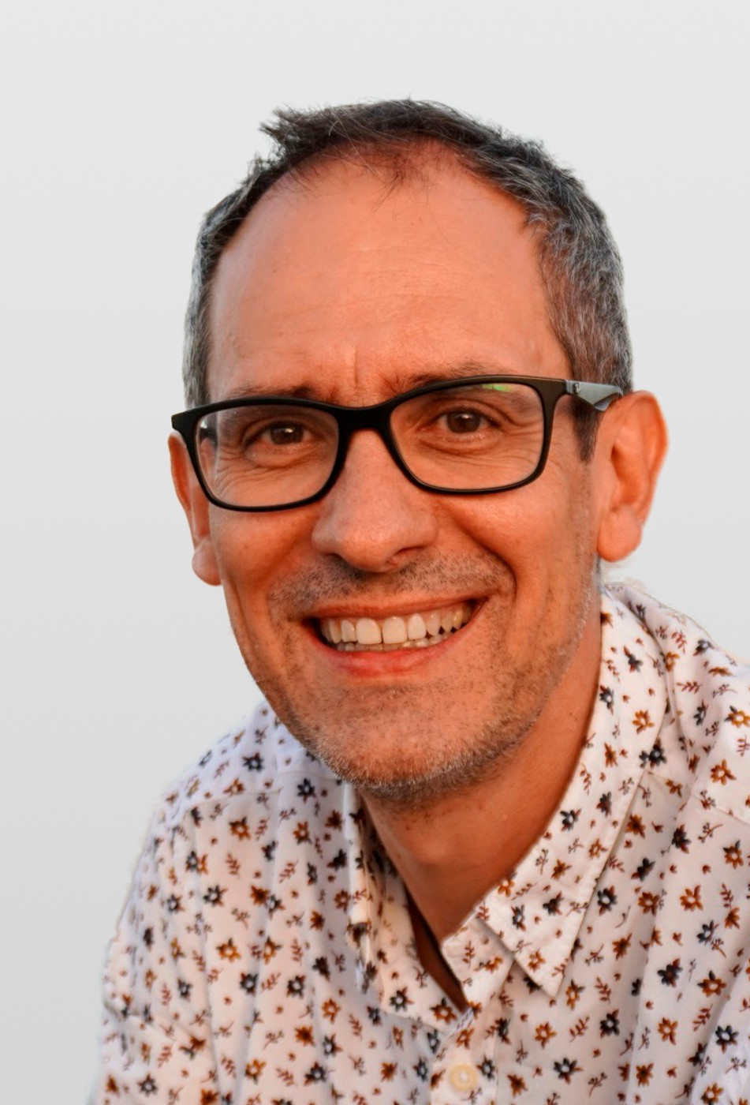
Esteban García Secretary of the Board
Esteban García has been a member of the Board of World Vision Spain since September 2020 and now holds the position of Secretary of the Board.
He has a doctorate in Senior Business Management and an expert in Organization Design and Transformation. He has extensive experience in the field of Management and strategic consulting. University professor specializing in “Digital Transformation” and “People-centered strategic design.” He specializes in digital transformation models aimed at improving the competitiveness of organizations by helping them gain a better perspective on the relationship with their clients.
He is the Committee Chair of the Business Development and Marketing Committee and a member of the Audit and Risk Committee.
https://www.linkedin.com/in/estebangarciaperez/

Slide 5
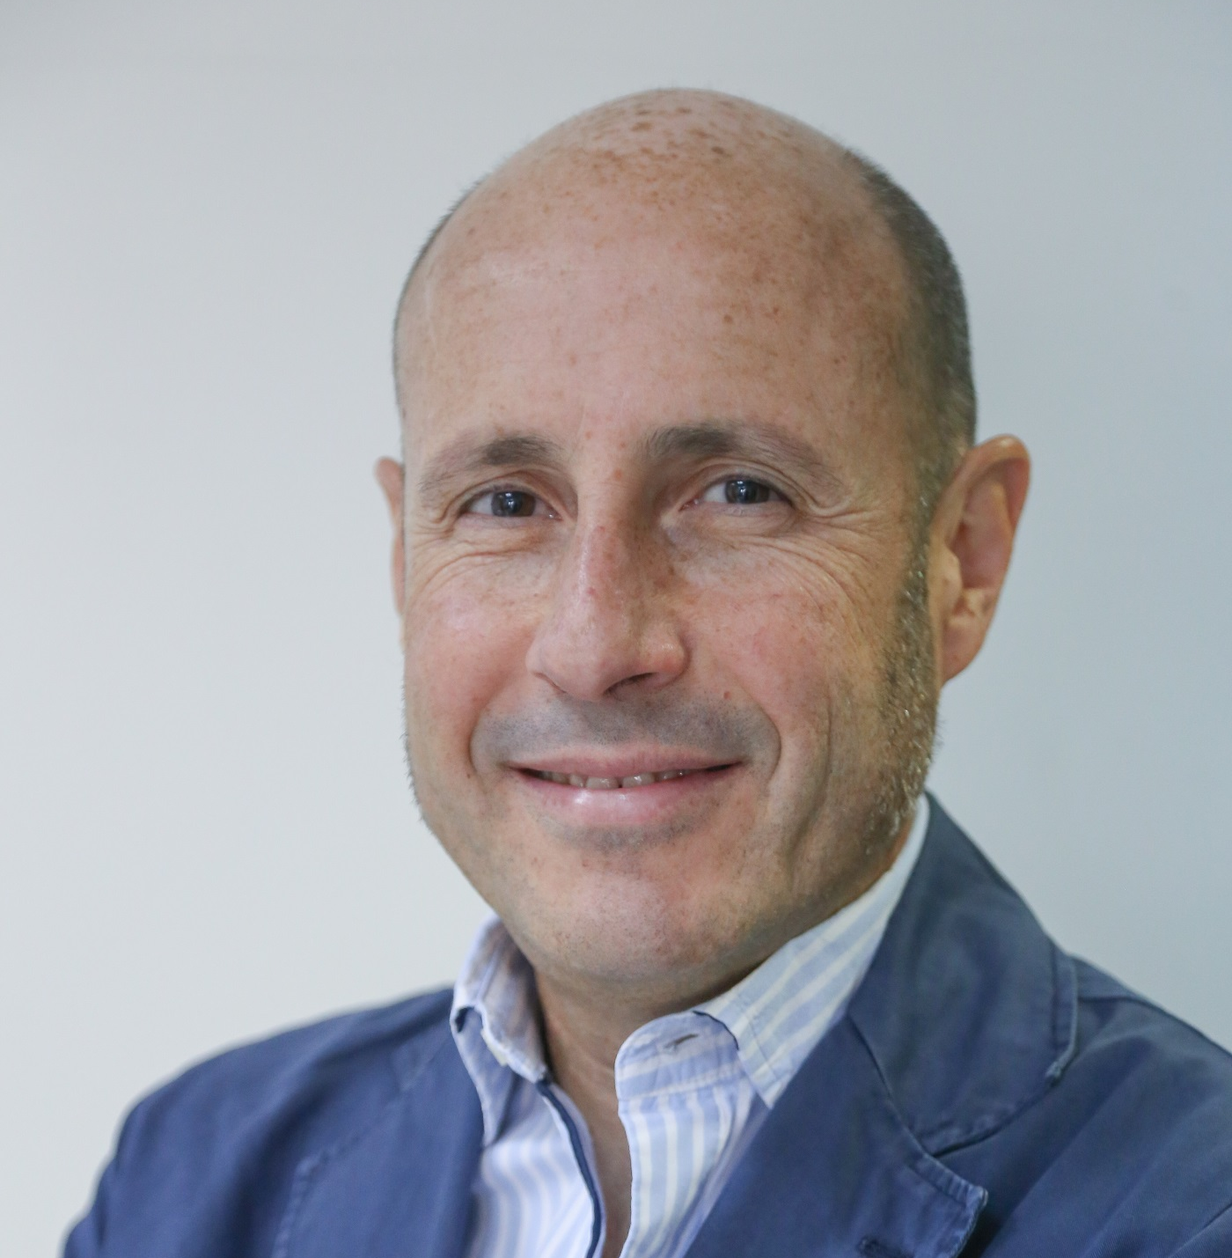
Alberto Pastor
Alberto Pastor joined the board in 2015 and he was Board Chair for 2 and a half years between June 2020 and January 2023.
Experienced Business Partner with a demonstrated background in marketing and advertising industry. Skilled in Management, Strategic Planning, CRM and Customer Experience, B2B Marketing, Research and Digital Marketing.
He is member of the Business Development and Marketing Committee.
https://www.linkedin.com/in/albertopastoresteban/

Slide 6
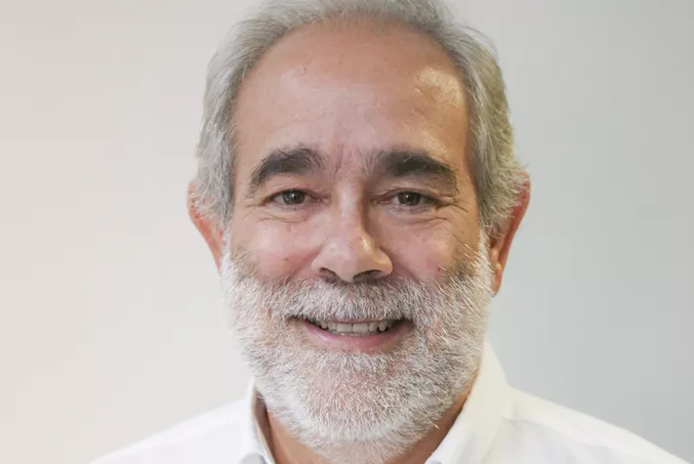
Jose Luis Andavert
Jose Luis Andavert has been a member of the board since 2018 but he was already serving our board as Board Chair for 9 years When world vision opened his office in Spain in 2003
He was general director of the Spanish Bible Society since 1986. Married to Dámaris Rodrigo. They have four children: Joshua, Eunice, Samuel and Mark. He resides in Madrid. He is a Baptist pastor UEBE (Evangélica Baptist Union of Spain) and member of the First Evangelical Baptist Church of Madrid
He is the Committee Chair of the Faith and Development Committee.
https://www.linkedin.com/in/jos%C3%A9-luis-andavert-escriche-616b3615b/

Slide 7
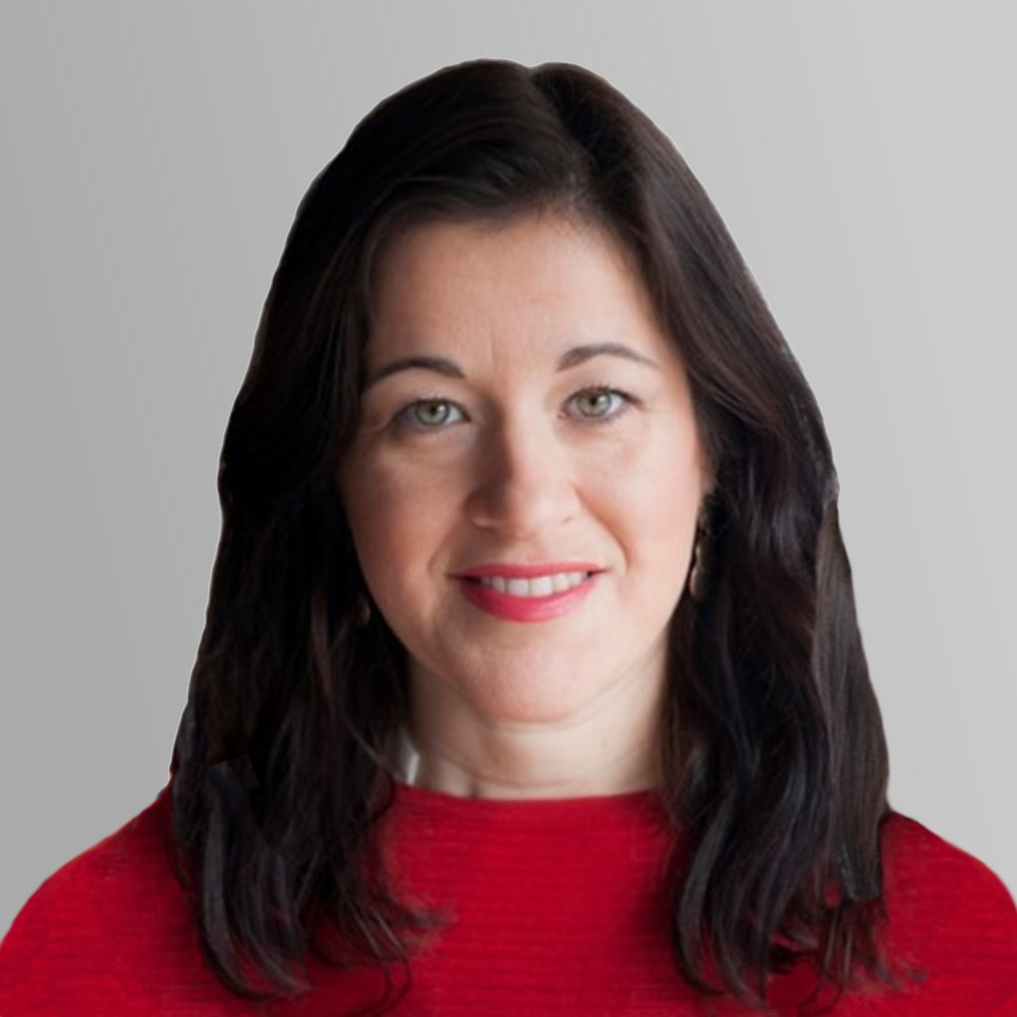
Carolina Bueno
Carolina Bueno has been a member of the Board of World Vision Spain since September .
Lawyer. Since 2002 she has served the Churches Evangelicals in FEREDE with vocation and dedication. Her desire is continue putting all her training and experience to the service of the evangelical people and religious freedom in our country.
She is the Committee Chair of the Governance, Development and Nominees Committee.
https://www.linkedin.com/in/carolina-bueno-calvo-222a35199/

Slide 8
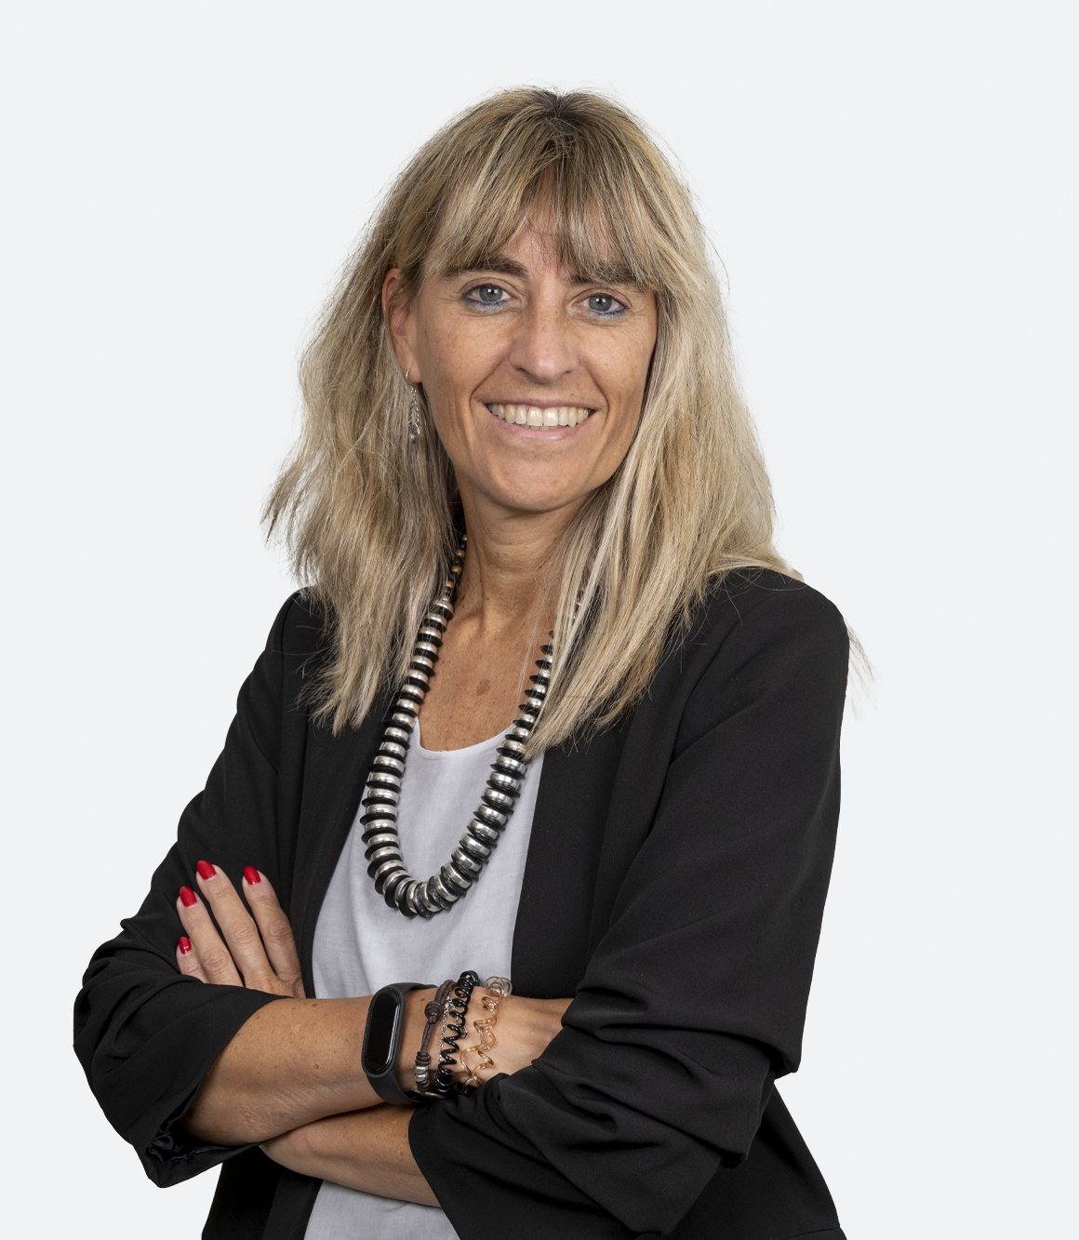
Marisa de Landecho
Marisa de Landecgo has been a member of the Board of World Vision Spain since September 2022.
Talented Senior Executive with 30 years of hands-on experience and proven track record of success. Provides proactive leadership, oriented to drive and deliver financial and business profitable growth. Skilled in fostering teamwork, and in motivating teams to perform with excellence and passion. Business leader with broad experience in large multinationals, with local and European roles. Combines strategic and tactical financial expertise with recognized expertise in: Business Development, Expansion and greenfield, Profitability and Cost Management, Financial Planning, Forecasting and Analysis, Accounting, Control and Financial Operations, Acquisitions and integration, System implementation and change management and team and Organizational Leadership.
Se is the Committee Chair of Audit and Risk Committee and a member of the Governance, Development and Nominees Committee.
https://www.linkedin.com/in/maria-luisa-landecho-soria-19336713/

Slide 9
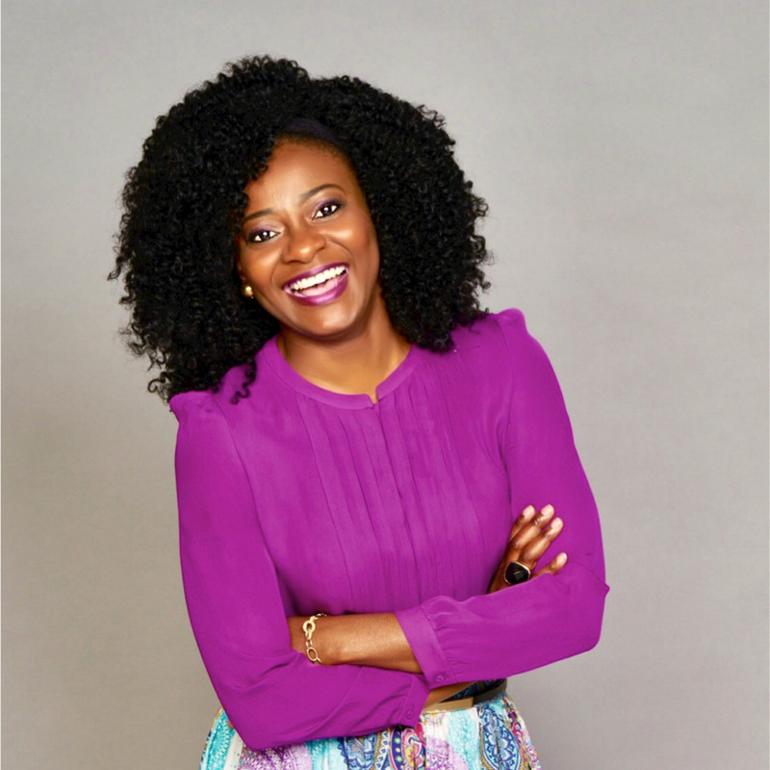
Jane Oma Onyemenam Okoye
Jane joined the board January 2023.
She is a Management Consultant with experience in People and Organizations and Organizational Culture.
With strong business and leadership skills, she is passionate about Africa and Africans, and in 2014 she founded Upside Africa. Upside Africa is a non-governmental and non-profit organization whose main objective is to inspire, support and promote African professionals and entrepreneurs (women and youth) in the diaspora and in Africa.
She also runs a Mentoring Academy known as The Mother Eagle Mentoring Academy, again focusing on women and youth.
She is a member of the CGDN
https://www.linkedin.com/in/jane-oma-onyemenam/

Slide 10
Lara Villar
Lara Villar joined the board September 2023 as WVI President and CEO’s representative in the Spanish Board.
Non-profit leader and passionate advocate for women's and children's rights with over 18 years of experience who melds a track record of leadership positions at a range of NGOs with solid experience in strategy and management. Innovative, emotionally intelligent leader and strategic thinker with proven ability to achieve results in a high-paced, high-pressured environment.
https://www.linkedin.com/in/lara-villar-3113608/

